Slide 1
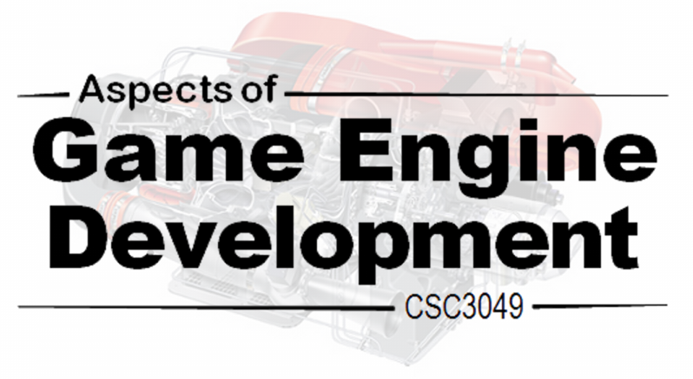
2.7. Spatial Partitioning
Overview of different forms of bounding volume hierarchy

Slide 2
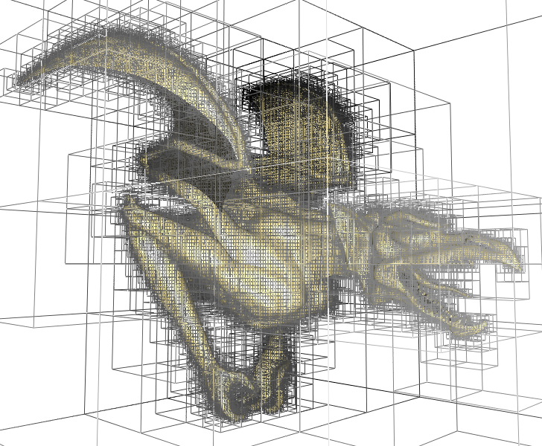
Spatial Partitioning
Approach to spatial decomposition of use within games

Slide 3
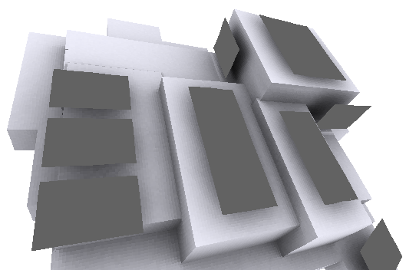
Spatial Partitioning
As with the use of bounding volume hierarchies, the goal behind spatial partitioning approaches is to restrict the number of pairwise tests that need to be performed within broad-phase processing.
Spatial partitioning techniques operate by dividing space into a number of regions that can be quickly tested against each object.
Two types of spatial partitioning will be considered: grids and trees.
Additionally, a spatial sorting approach will also be considered.

Slide 4
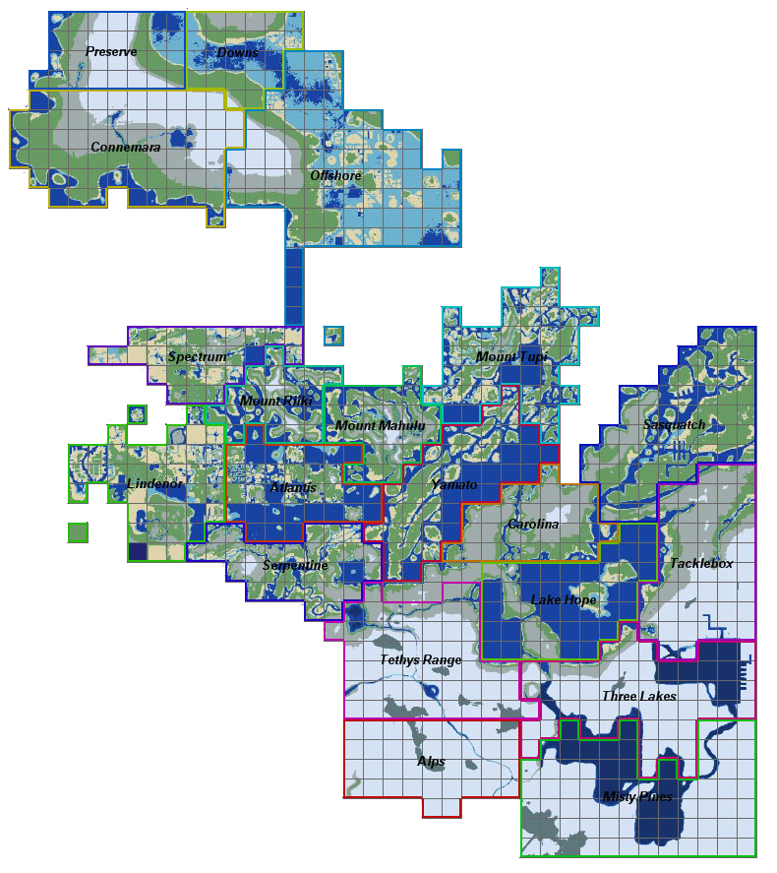
Uniform Grids
Using grids to decompose space

Slide 5
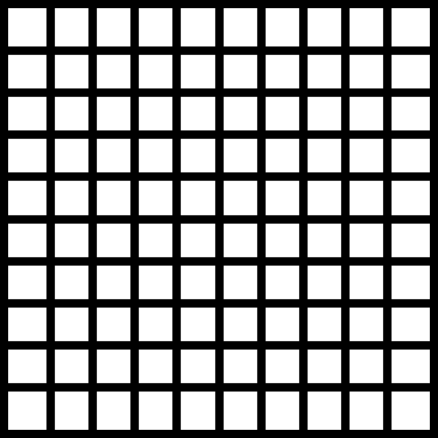

Uniform grids
A simple but effective spatial decomposition scheme is to simply overlay space with a uniform grid (i.e. comprising a number of equal sized regions (or cells)).
As only those objects which overlap a common cell(s) can be in contact, intersection tests are only performed against objects which share cells.
Given grid uniformity, converting between a spatial coordinate and the corresponding cell is trivial. Additionally, given a particular cell, neighbouring cells are also easily located.
Because of the conceptual and implementational simplicity grids are a decent choice.
Aside: Grids are sometimes also termed regions, buckets, sectors, or zones.

Slide 6
Uniform grid performance issues
Aside: Cell size is often selected to be large enough to fit the largest object at any rotation (i.e. number of overlapping cells is no more than 4 for a 2D grid). The issues of large object size variance can be addressed using hierarchical grids (see directed reading)
The choice of cell size represents a core performance issue. In particular, performance may be negatively impacted if:
1. The grid is too fine. A large number of cells must be updated whenever a (relatively) large object is added or moved.
2. The grid is too coarse. A larger number of (relatively) small objects will likely result in a high object density within each cell (increasing the amount of pirewise testing).
3. The grid is both too fine and too coarse. The first two problems can be both encountered if object sizes vary a lot.

Slide 7
Representing grids as an array of linked lists
The most obvious means of storing objects within a grid is to define an array (with a matching dimensional size to that of the grid) of linked lists.
By using a double linked list and storing a direct reference to the linked-list item within each object it is possible to obtain O(1) insertion, deletion and update costs.
The main drawback of this approach is the high (possibly prohibitive) memory size needed to store a large grid.
[0]
[1]
[2]
Object
Object
Object
Object
Object
Object
Object

Slide 8
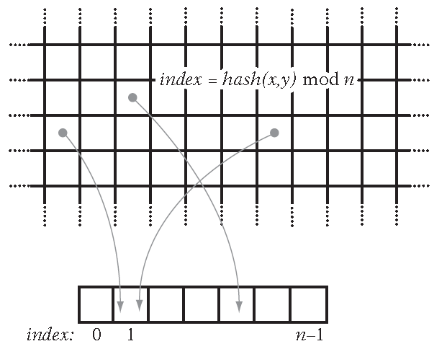
Representing grids using hashed storage
Extremely large grids can be efficiently represented if each cell is mapped onto a hash table of a fixed set of n buckets, with each bucket containing a linked list of objects.
As such the grid is conceptual and does not use memory. The grid can be assumed to be unbounded in size with memory usage (i.e. Hash table size dependent upon the number of objects).
Aside: In order to be effective, the use of hashed storage requires a good hashing function to map coordinates onto buckets.

Slide 9
Testing for object-to-object grid intersection
Assuming that grid cell sizes are larger than the largest object, i.e. an object can, at most, overlap immediately neighbouring cells.
When inserting an object into the grid it may only be added to one representative cell, or alternatively, to all cells which it overlaps.
When determining cell overlap the two most common object feature to use are the object’s bounding sphere centre or the minimum corner of the axis-aligned bounding box.
Representative cell
Overlapping cells
Minimum AABB corner
Bounding sphere centre

Slide 10
Single test for object-to-object intersection
If objects are associated with a single cell (i.e. neighbouring cells must also be tested for intersection) then object-to-object intersection is (assuming a 2D grid):
If using sphere bounding sphere centre positioning:
If using AABB minimum corner point
check object cell
check NW cell
check N cell
check NE cell
check W cell
check E cell
check SW cell
check S cell
check SE cell
check object’s cell
check N cell
check NW cell
check W cell
if (object overlaps E cell) {
check NE cell
check E cell
}
if (object overlaps S cell) {
check SW cell
check S cell
if (object overlaps E cell)
check SE cell
}
If using a AABB corner point at worst nine and at best only four cells will need to be checked (i.e. this is a better feature to use for a single object-to-object test).

Slide 11
Single test for object-to-object intersection
Furthermore, if objects are stored in all cells they overlap then the single object-to-object test can be further simplified as only the exact overlapping cells need be tested, i.e.:
If using AABB minimum corner point and objects are placed in all overlapping cells
check object’s cell
if (object overlaps E cell)
check E cell
if (object overlaps S cell) {
check S cell
if (object overlaps E cell)
check SE cell
}
The best case is now a single test and the worst case is four tested cells. However, more effort and memory must be used when updating moving objects (i.e. updating all overlapping cells). Additionally, a pair collision status must be maintained as intersection between two objects may be reported multiple times (from different cells).

Slide 12
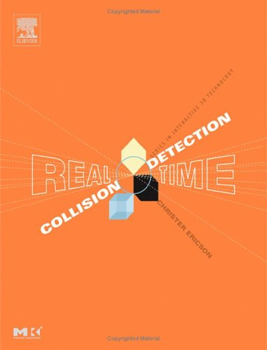
Other grid sections
Consult the recommended course text for details of the following:
All Tests at a Time for Object-to-object Intersection
Implicit Grids
Hierarchical Grids

Slide 13
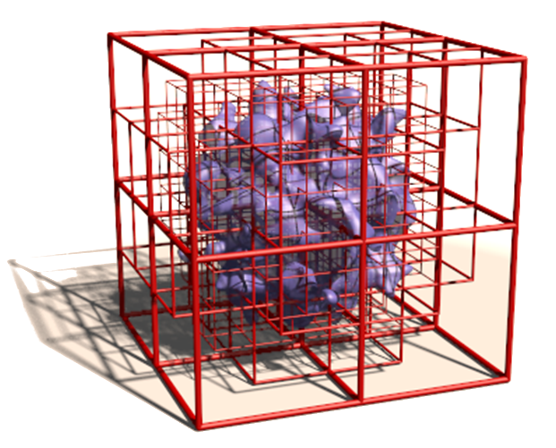
Tree Based Spatial Decomposition
Hierarchical decomposition of space using octrees and k-d trees

Slide 14
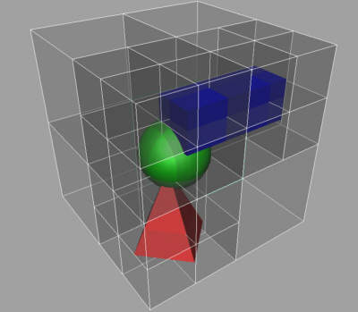
Octrees (and quadtrees)
An octree is an axis-aligned tree-based hierarchical partitioning of space. The root node is typically the smallest AABB which fully encloses the world. Each tree node can be divided into eight smaller regions of space (i.e. each node has eight octants (also known as cells)) by dividing the cube in half along each of the x, y, and z axes.
Typically the root node is recursively subdivided until either some maximum tree depth or minimum cube size limit is reached.
Aside: The 2D equivalent to the 3D octree is known as the quadtree.

Slide 15
Octree assignment
Octrees can be constructed to hold either static or dynamic data.
Static data: Octree formed using a top-down approach. All objects initially associated with the root node. As the root node is split, objects are assigned to all the child nodes it overlaps. The process is recursively repeated until some stopping criteria is reached (e.g. max depth, min objects per cell, etc.).
Dynamic data: Octree formed by restricting objects to the lowest octree node that fully contains the object. This ensures that each object is only held once within the tree, but will result in some objects (e.g. those crossing a partitioning plane regardless of size) being stored at a higher position in the tree (i.e. increasing intersection costs).

Slide 16
struct Node {
Point Center; // Node centre point
float HalfWidth; // Node half width
Node[] Child; // Eight children nodes
LinkedList Objects; // Stored objects
Assumed node structure
Octree assignment
If objects are restricted to a single cell, the insertion algorithm is:
void InsertObject(Node treeNode, Object object)
{
int index = 0;
bool straddle = false;
for (int i = 0; i < 3; i++) {
float delta = object.Center[i] – treeNode.Centre[i];
if (abs(delta) < treeNode.HalfWidth + object.Radius) {
straddle = true; break;
}
if (delta > 0.0f) index |= (1 << i);
}
if (!straddle && CanInsertObject(treeNode.Child[index]) {
InsertObject(treeNode.Child[index], object);
} else {
InsertObject(treeNode, object);
}
}
Determine which octant the object’s centre (assuming sphere bound) is in, testing if any child dividing plane is crossed.
Performed a bitwise shift using the index and add the result to the index (i.e. building up the child index)
If the object can be cleanly inserted into a child then do so (additional tests, such as max tree depth, could also be included here).
The insert method may need to create a new node if the current child branch is null
The object straddles a boundary or cannot be added to a child, so add here.

Slide 17
Octree object-to-object intersection
Object-to-object intersection testing with an octree can be implemented as:
A stack structure is used to keep track of all ancestor object lists
static Node[] ancestorStack = new Node[MAX_DEPTH];
static int depth = 0;
void TestAllCollisions(Node treeNode)
{
ancestorStack[depth++] = treeNode;
for (int n = 0; n < depth; n++) {
foreach (Object a : ancestorStack[n].Objects) {
for (Object b : treeNode.Objects ) {
if (a == b) break;
TestCollision(pA, pB);
}
}
}
for (int i = 0; i < 8; i++)
if (treeNode.Child[i] != null )
TestAllCollisions(treeNode. Child[i]);
depth--;
}
Check for collisions between all objects on this level and those in ancestor nodes. The current level is added to the stack to ensure all pairwise tests are covered.
Initially for each call, depth will be = 0
Avoid comparing the object to itself
Recursively call each child
Finally, remove this node from the ancestor stack before returning up the call chain

Slide 18
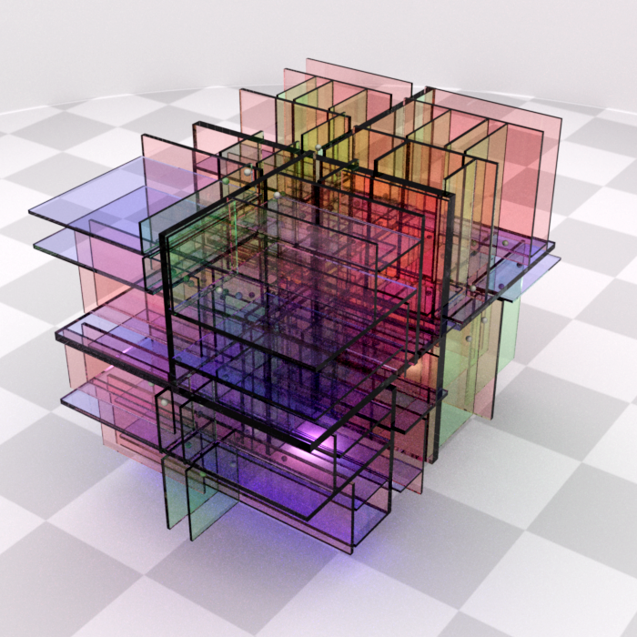
K-d trees
The k-dimensional tree (or k-d tree) is a generalisation of octrees and quadtrees, where k represents the number of dimensions subdivided.
Instead of simultaneously dividing space in two (quadtree) or three (octree) dimensions, the k-d tree divides space along one dimension at a time.
Traditionally, k-d trees are split along x, then y, then z in a cyclic manner. However, often the splitting axis is freely selected among the k dimensions.
Because the split is allowed to be arbitrarily positioned along the axis, this results in both the axis and splitting value being stored in the k-d tree nodes.

Slide 19
K-d trees
Aside: The BSP tree, explored next, can be regarded as a less restrictive form of k-d tree.
One level of an octree can be regarded as a three-level k-d tree split along x, then y, then z where all splits divide the space in half.
Splitting along one axis at a time entails more simple execution code as only the intersection with a single plane must be considered in each cell (further helped by the requirement that the splitting plane is axis aligned).

Slide 20

Sort and Sweep Methods
Maintaining a spatially sorted collection of objects

Slide 21
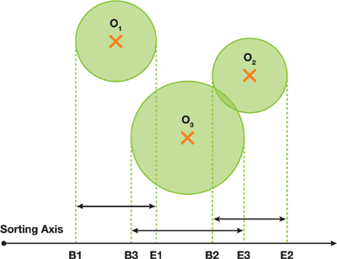
Sort and Sweep Methods
One drawback of inserting objects into fixed spatial subdivisions (grids, octrees, etc.) is having to handle objects straddling multiple partitions.
An alternative approach is to maintain a sorted spatial ordering of objects. A common means of accomplishing this is known as the sort and sweep method.
Typically the projections of object’s AABBs onto the x, y, and z axes are maintained in a sorted list of the start and end values for each AABB projection.

Slide 22
Sort and Sweep Methods
The collisions for a single object can, on average, be found in near constant time by querying only those neighbouring objects that fall within the projection interval of the tested object.
Generally, the list will remain mostly sorted as most objects do not move far between frames, i.e. an insertion sort can be used (O(n) for nearly sorted lists). However, temporal coherence can break down due to clustering of objects (increasing sorting costs). Such clustering is common along certain axis (e.g. gravitational axis)

Slide 23
Sort and Sweep Methods
One solution is to avoid sorting on the axis on which objects tend to cluster, e.g. only tracking the x and z axes. In most situations, sorting on two axes is likely to be sufficient (and also reduces memory overhead).
Axes other than the standard x, y and z axes may also be selected.
Refer to the recommended course text for details of how a sort and sweep method can be implemented using linked lists.
The linked-list approach can handle a large number of objects, and entails that very little effort is typically required to maintain the data structure from frame-to-frame.

Slide 24
Sort and Sweep: Array Implementation
A disadvantage of a linked-list implementation of a sort and sweep approach is the memory cost needed to hold a large collection of objects (alongside a high sort cost following clustering).
Arrays offer an alternative, using less memory but more inflexible when dynamically handling objects (i.e. removing single object update might entail the entire array needs to be updated). Using arrays also simplifies the code and provides cache-friendly accessing of memory.
An example implementation is next provided (operating on an array of the following data structure):
struct AABB
{
Point Min
Point Max
}
int NumObjects
AABB[] ObjectBounds

Slide 25
Sort and Sweep: Array Implementation
int SortAxis = 0;
void SortAndSweepAABBArray(AABB[] ObjectBounds)
{
Sort(ObjectBounds, NumObjects, SortAxis);
float sum[3] = {0.0,0.0,0.0}, sum2[3] = {0.0,0.0,0.0}, variance[3];
for (int i = 0; i < NumObjects; i++) {
Point p = 0.5f * (ObjectBounds[i].Min + ObjectBounds[i].Max);
for (int c = 0; c < 3; c++) {
sum[c] += p[c]; sum2[c] += p[c] * p[c];
}
for (int j = i + 1; j < NumObjects; j++) {
if (ObjectBounds[j].Min[SortAxis]
> ObjectBounds[i].Max[SortAxis]) break;
if (AABBOverlap(ObjectBounds[i], ObjectBounds[j]))
TestCollision(ObjectBounds[i], ObjectBounds[j]);
}
}
Axis along which the sweep sort should proceed (0,1,2 mapping onto x,y,z).
Sort the array using an appropriate form of sort process (e.g. incremental sort if temporal coherence assumed, otherwise quicksort, etc.). Sort axis determines which axis should be sorted.
Two arrays are defined to measure the AABB variance along each of the x, y and z axes (holding the sum and sum² of AABB centres).
Sweep the array looking for collisions
Determine the AABB centre point
Update sum and sum2 as a measure of AABB center variance along each axis
Test for collisions against all possible overlapping AABB
Break whenever the tested AABB falls outside the bounds of the current AABB
If AABB overlap on other axis, then test for collision

Slide 26
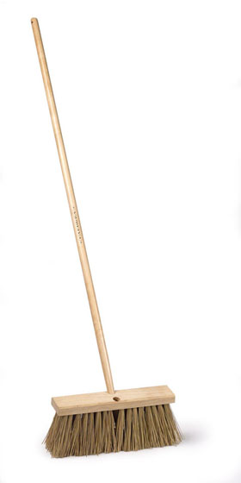
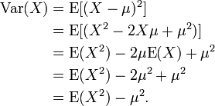
Sort and Sweep: Array Implementation
Update the variance using the latest sweep.
for (int c = 0; c < 3; c++)
variance[c] = sum2[c] - sum[c] * sum[c] / NumObjects;
SortAxis = 0;
if (variance[1] > variance[0]) SortAxis = 1;
if (variance[2] > variance[SortAxis]) SortAxis = 2;
}
Select the next axis to be sorted and swept.
Aside: The variance of X within some distribution E with mean μ is:

Slide 27
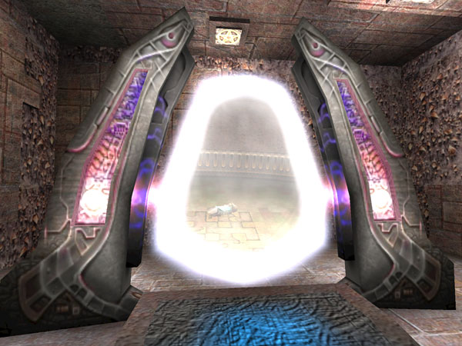
Cells and Portals
Subdividing space into a number of connected regions

Slide 28
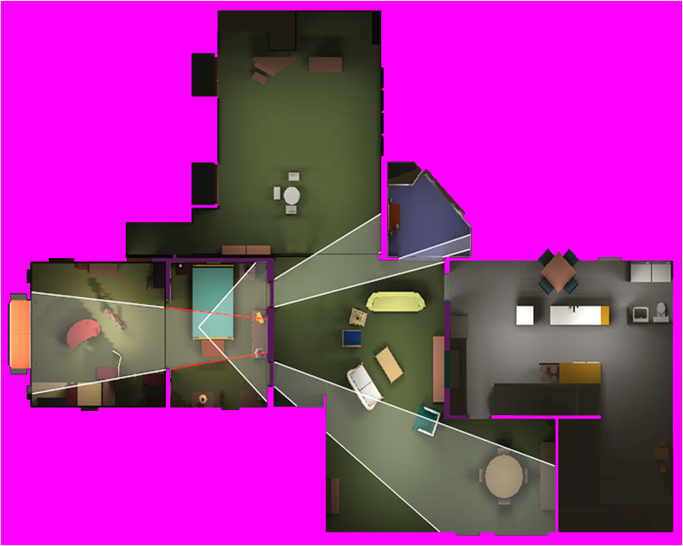
Cells and portals
A cells-and-portals method is often used to provide an efficient scene graph for rendering, and can also be used within a collision detection system.
The method is often used to model heavily occluded environments with high depth complexity (e.g. indoor environments)
.

Slide 29
Cells and portals
The method proceeds by dividing the world into regions (cells) and the boundaries that connect them (portals). The portals define connections between cells and both directly and indirectly determines which cells can be viewed from a given cell.
Aside: Rendering a scene starts with drawing the geometry in the cell containing the camera.
The rendering function is recursively called for adjoining cells whose portals are visible to the camera.
During recursion, portals are clipped against the current portal, narrowing the view. Recursion stops when the clipped portal becomes empty or no unvisited neighbouring cells are available.

Slide 30
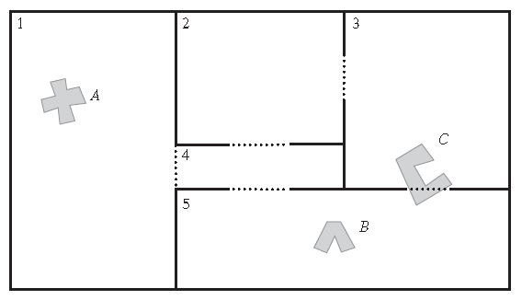
Cells and portals
The same cells-and-portals structure can also be used for collision detection queries.
Objects are associated with the cells containing their centre point. Following movement, a ray test can be used to check if the object has left its current cell.
For object-object queries, given an object A only the objects in A’s assigned cell and those in adjoining cells whose portal A overlaps must be checked. For object-world collisions only the polygons in the current cell and those of any overlapped cells must be checked against

Slide 31

Directed Reading
Directed
reading
Directed mathematical reading

Slide 32


Directed reading
Directed
reading
Read Chapter 7 of Real Time Collision Detection (pp285-346)
Related papers can be found from:
http://realtimecollisiondetection.net/books/rtcd/references/

Slide 33

Summary
Today we explored:
Spatial decomposition approaches
Including grids, trees, sweep and sort and portal based approaches
To do:
Read the directed material
After reading the directed material, have a ponder if this is the type of material you would like to explore within a project.

